Slide 1
CODEIGNITER
Matakuliah Web Programming

Slide 2
Controller
Membuat Controller Baru Hello

Slide 3
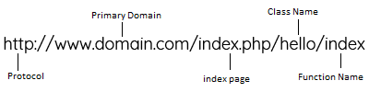
Domain Codeigniter

Slide 4
Hello.php
01
Hello.php
<?php
class Hello extends CI_Controller{
function index(){
echo "Hello World";
}
}

Slide 5
Hello.php
01
Hello.php
<?php
class Hello extends CI_Controller{
function index(){
echo "Hello World";
}
function show(){
echo "I Make The World Better Place.";
}
}

Slide 6
Controller dan VIEW
Membuat Controller DAN View

Slide 7
Hello.php
Blog.php
<?php
class Blog extends CI_Controller
{
function __construct()
{
parent::__construct();
}
function index(){
$this->load->view('blog_view');
}
}

Slide 8
Blog_view.php
blog_view.php
<!DOCTYPE html>
<html lang="en">
<head>
<meta charset="utf-8">
<title>My Blog</title>
</head>
<body>
<h1>Welcome To My Blog.</h1>
</body>
</html

Slide 9
Controller dan VIEW
Membuat Controller DAN View

Slide 10
Hello.php
Blog.php
<?php
class Blog extends CI_Controller
{
function __construct()
{
parent::__construct();
}
function index(){
$data['title'] = "This Is Title";
$data['content'] = "This Is The Contents";
$this->load->view('blog_view',$data);
}
}

Slide 11
Blog_view.php
blog_view.php
<!DOCTYPE html>
<html lang="en">
<head>
<meta charset="utf-8">
<title><?php echo $title;?></title>
</head>
<body>
<h1><?php echo $content;?></h1>
</body>
</html>

Slide 12
CODEIGNITER & BOOTSTRAP
Membuat Tampilan Menggunakan Framework CSS Bootstrap

Slide 13
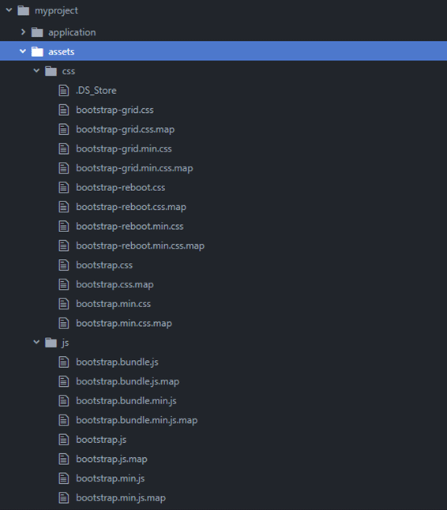
Tambahkan Folder Asset di dalam Folder Latihan Codeigniter

Slide 14
Blog_view.php
blog_view.php
<!DOCTYPE html>
<html lang="en">
<head>
<meta charset="utf-8">
<title><?php echo $title;?></title>
<!-- load bootstrap css file -->
<link href="<?php echo base_url('assets/css/bootstrap.min.css');?>" rel="stylesheet">
</head>
<body>
<div class="container">
<div class="jumbotron jumbotron-fluid">
<div class="container">
<h1 class="display-4"><?php echo $content;?></h1>
<p class="lead">This is my first blog.</p>
</div>
</div>
</div>
<!-- load jquery js file -->
<script src="<?php echo base_url('assets/js/jquery.min.js');?>"></script>
<!-- load bootstrap js file -->
<script src="<?php echo base_url('assets/js/bootstrap.min.js');?>"></script>
</body>
</html>

Slide 15
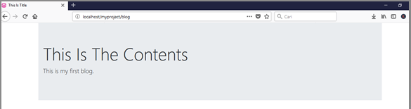
Blog_view.php

Slide 16
Blog_view.php
blog_view.php
<!DOCTYPE html>
<html lang="en">
<head>
<meta charset="utf-8">
<title><?php echo $title;?></title>
<!-- load bootstrap css file -->
<link href="<?php echo base_url('assets/css/bootstrap.min.css');?>" rel="stylesheet">
</head>
<body>
<div class="container">
<h1><?php echo $content;?></h1>
<table class="table table-striped">
<thead>
<tr>
<th scope="col">#</th>
<th scope="col">First</th>
<th scope="col">Last</th>
<th scope="col">Handle</th>
</tr>
</thead>

Slide 17
Blog_view.php
<!DOCTYPE html>
<html lang="en">
<head>
<meta charset="utf-8">
<title><?php echo $title;?></title>
<!-- load bootstrap css file -->
<link href="<?php echo base_url('assets/css/bootstrap.min.css');?>" rel="stylesheet">
</head>
<body>
<div class="container">
<h1><?php echo $content;?></h1>
<table class="table table-striped">
<thead>
<tr>
<th scope="col">#</th>
<th scope="col">First</th>
<th scope="col">Last</th>
<th scope="col">Handle</th>
</tr>
</thead>

Slide 18
Blog_view.php
<tbody>
<tr>
<th scope="row">1</th>
<td>Mark</td>
<td>Otto</td>
<td>@mdo</td>
</tr>
<tr>
<th scope="row">2</th>
<td>Jacob</td>
<td>Thornton</td>
<td>@fat</td>
</tr>
<tr>
<th scope="row">3</th>
<td>Larry</td>
<td>the Bird</td>
<td>@twitter</td>
</tr>
</tbody>
</table>
</div>
<!-- load jquery js file -->
<script src="<?php echo base_url('assets/js/jquery.min.js');?>"></script>
<!-- load bootstrap js file -->
<script src="<?php echo base_url('assets/js/bootstrap.min.js');?>"></script>
</body>
</html>

